Slide 1
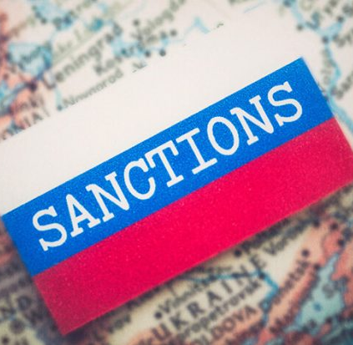
Russia Sanctions: Tool of Persuasion or Something More?
Anne Harrington
May 3, 2022

Slide 2
Why do we use sanctions?
Resolve conflicts
Internal conflict
Mali, Central African Republic
External conflict
Russian invasion of Ukraine (2014 & 2022)
Influence behavior that is not consistent with global norms
Apartheid policy in South Africa
Discourage support for terrorism and human rights abuses
Iran
Prevent nuclear weapon proliferation
DPRK
Violation of international norms

Slide 3
What kind of sanctions are there?
Economic sanctions – commercial and financial penalties that restrict normal trade and financial relations, such as:
Import duties on goods from the sanctioned country/restricting export of particular goods to the country
Blocking financial transactions or seizing assets (bank accounts, property)
Blocking the sanctioned country’s ports
Ban on trade (can be limited to certain sectors such as armaments), or with certain exceptions (such as food and medicine)
Can target sectors or individual companies
Travel bans
Diplomatic sanctions –reduce or remove of diplomatic presence, such as embassies and consulates; cancel high level contacts; boycott meetings/conferences; exclude from international organizations (G8/G7)
Military sanctions –from arms embargoes to military intervention
Sport sanctions – prevent people and teams from sanctioned country from competing in international events.
Sanctions related to Environment – relative new, but could apply to greenhouse gas emissions; endangered species

Slide 4
Who imposes sanctions?
United Nations
Role of Security Council
Political and Economic Unions
European Union
Eurasian Economic Union?
Nations
Different organizations are responsible for enforcing sanctions, depending on the treaty or laws that apply
New Actors
“Anonymous” hacking group declared war on Russia, but they have no legal personality or international standing
Will there be more new actors who can act independently?

Slide 5
Other consequences
Sanctions also resulted in the voluntary withdrawal from the Russian market of many US, European, Japanese, Korean, Canadian and other companies
Lack of access to foreign currency markets means that Russia will default on its loans and lose its credit rating, affecting its ability to borrow money on the international markets in the future
Russia can also apply sanctions or introduce retaliation measures
Retaliation measures can include
Cutting off supply of gas to Poland and Bulgaria because of their support for Ukraine
Boycott purchase of certain goods (Russian boycott against EU fruit in 2014)
Travel ban on ‘unfriendly’ individuals to enter Russia (e.g. UK parliamentarians, senior US & Canadian officials, etc.)

Slide 6
How are sanctions turned on?
Complicated question
Russia case involves many different countries acting in coordination
Each has its own jurisdiction and laws
Even if the intent is to coordinate sanctions, the difference in process may mean that similar measures are put in place at different times
Executive Action
Many issues can be decided by executive orders without having to pass through a legislative or parliamentary process (some banking restrictions, diplomatic sanctions, etc)
Others require more complicated procedure
In US, removing Russia from Most Favored Nation trade status required an act of Congress; same is true to restore Russia to that status

Slide 7
How are sanctions turned off?
Also complicated
Sanctions usually imposed because of disapproval of behavior or actions
Can specific sanctions correspond to specific actions
Ex: If Russia stops bombing Ukraine, is it given relief from some kind of sanction?
Normally not a 1:1 calculation
Sanctions normally imposed relatively quickly to respond to a stressful situation
Removing them not just a strategic/political decision, but can also be an emotional one
Twitter @DMokryk: “The day some future Russian president kneels in the Ukrainian city of Mariupol and asks Ukrainians and humanity for forgiveness – would be the first day it would be decent to start any debate on lifting sanctions against Russia.”
Current situation very unusual because main sanctions on Russia have been imposed by countries other than Ukraine, but Ukraine must be involved in the discussions about how/when to lift sanctions

Slide 8
Russia now the most sanctioned country in history
(I will try to show one of these website)
https://graphics.reuters.com/UKRAINE-CRISIS/SANCTIONS/byvrjenzmve/
https://www.piie.com/blogs/realtime-economic-issues-watch/russias-war-ukraine-sanctions-timeline

